Slide 1
Chapter 13
Using STATISTICS AND SENSORS to ensure network availability

Slide 2
Performance metrics/sensors
Device/Chassis
Temperature
Overheating a main cause of reboots
PC usually cools itself with fans but may require additional cooling (liquid)
Dust is a major cause of overheating
CPU
We use counters to monitor the CPU
Processor\% Processor time
Time CPU spends executing and non-idle thread
Should not exceed 85%
Processor\% User time
Time spent doing work for an application
Should not exceed baseline
Processor\% Interrupt time
Time spent servicing hardware interrupts
Should not be over 15%
System\Processor Queue Length
Number of threads in queue
Should not exceed number of CPU’s
Notes:
Temperature: can be an early sign of overutilization or hardware issues
This is important to monitor, so that you can keep your devices and servers running w/ optimal performance
Overheating will usually send your computer into constant rebooting
Make sure to clean your fan
Do not obstruct air flow into your computer
CPU Usage: is the metric to determine how hard your device is working
Use vendor documentation in how to counteract issues with CPU

Slide 3
Performance metrics/sensors
Memory
Memory\% Committed Bytes in Use
Virtual memory in use
>80% more memory is required
Memory\Available Mbytes
Physical memory available
<5% more memory is required
Memory\Free System Page Table Entries
Number of entries not in use
<5000 may have a memory leak
Memory\Pool Non-Paged Bytes
The size of objects that cannot be paged to the disk
>175MB may have a memory leak
Memory\Pool paged Bytes
Size of objects that can be paged
>250MB may have memory leak
Memory\Pages per Second
Writing and read rate during paging
>1000 may be a memory leak
Notes:
Make sure to have enough memory because once a device reaches its capacity, it usually can no longer operate
Consult the vendor for specific documentation or information for specific services in relation to memory issues

Slide 4
Performance metrics/sensors
Network Metrics
Bandwidth
Network Interface\Bytes Total\Sec
NIC capability currently in use
>70% - interface is saturated
Network Interface\Output Queue Length
Packets in the output queue
>2- NIC is not keeping up
Latency
Consistent delay in traffic
Measured in Round Trip Time (RTT)
Jitter
Variance in delay
Notes:
Make sure to keep an eye on your bandwidth, if you exceed your bandwidth your network will suffer miserably
Latency: is the wait time between request and response
Everybody hates latency and slow internet right? Monitor it
Best way to monitor all these metrics is to grab a baseline when you first start working at a company
It is easier to troubleshoot issues when they can be identified early on
Jitter: the time between frames, when phone calls are choppy
These metrics showing issues can be an indication of malware on your devices or operating on your network

Slide 5
Interface Statistics/status
Link State
Is it up or down
First ting to check if we get a link error
Speed/Duplex
Both ends should match
Run the ‘ show running configuration command’ (sh run) to check interfaces on routers and switches
Usually set to Auto
Send/Receive Traffic
To check on interface you would run ‘ sh int <int>’
Cyclic Redundancy Checks (CRCs)
Error detection mechanism
Protocol Packet and Byte counts
To check you would run ‘sh int <int>
Notes:
First determine if the router and switch is operational
Use device manager to verify speed and duplex settings on a Windows device
CRC: When these errors occur, something has corrupted the received packet

Slide 6
Interface Errors or Alerts
CRC Errors
Damaged packet
Bad port, bad cable, duplex mismatch, etc
Giants
Packets that exceed the maximum packet size and/or incorrect frame check sequence
Usually discarded
Caused by a bad NIC
Runts
Packets that do not meet minimum packet size
Usually discarded
Caused by bad NIC
Encapsulation Errors
Missing header from OSI layer
Example- layer 3 missing layer 2 information. Cant forward
Notes:
CRC errors: can be caused by a faulty port on the device or a bad ethernet cable
Giants: packets that are discarded because they exceed the maximum packet size of the medium
Runts: packets that are discarded because they don’t meet the minimum packet size requirements
Encapsulation Error occurs when a header from the OSI layer is missing; switches are expecting different frames

Slide 7
SNMP
Ports 161 and 162
3 Versions
Version 3 should be used. 1 and 2 are unsecure and deprecated
Traps
Uses a Network management System to communicate with devices
Uses a GET message to query devices
Devices will send a trap when a problem occurs
Object Identifiers(OIDs)
Standardized mechanism to name objects or things with a globally unambiguous persistent name
In SNMP each node in a management information base (MIB) is identified by an OID
Management Information Bases (MIBs)
A hierarchical structure of OID’s
Notes:
Simple Network Management Protocol operates using Ports 161 and 162
Version 3 has message integrity checks, encryption, and authentication
It gathers data from devices on the network from a management station at fixed or random intervals
It records a baseline
It can be utilized as a watch dog to notify an administrator of events or sudden alarms
OIDs: are the stats gathered from network devices
MIB: a database of data

Slide 8
Environmental factors and sensors
Temperature
Humidity
Electrical
UPS
Multiple Circuits
Flooding
Severs/datacenters on upper floors or raised floors
Notes:
Server rooms or infrastructure rooms including routers, switches, etc should be in a cool room provided with a high powered HVAC system and proper ventilation
Humidity cant be to damp or too dry
Too dry causes static electricity
Too damp causes connections to corrode or shorts to occur
50% is the magic number of humidity
Make sure there are devices in those rooms/buildings to monitor these metrics

Slide 9
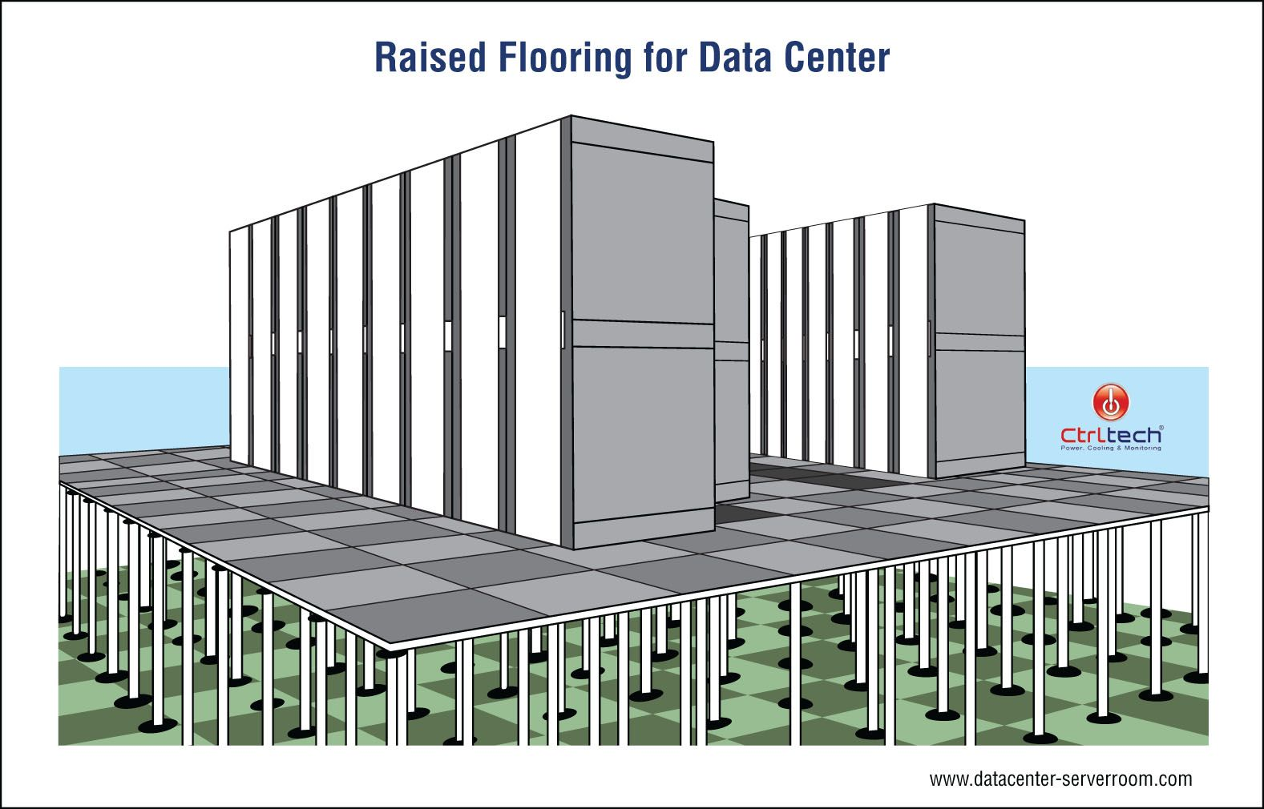
Notes:
Server rooms and data centers should be located on upper floors or have raised floors

Slide 10
Misc
Baselines
Netflow data
Uptime/downtime
99.99
99.999
Notes:
NetFlow: allows you to gather traffic statistics from all traffic flows and share the data over multiple devices
It has a probe and a collector, the probe sits out on the network collecting information and it sends the summary reports to the collector
Uptime/Downtime: status page to know if certain devices are up or down

